Slide 1
Edjeovation 2024
Mocking Mirror

Slide 2
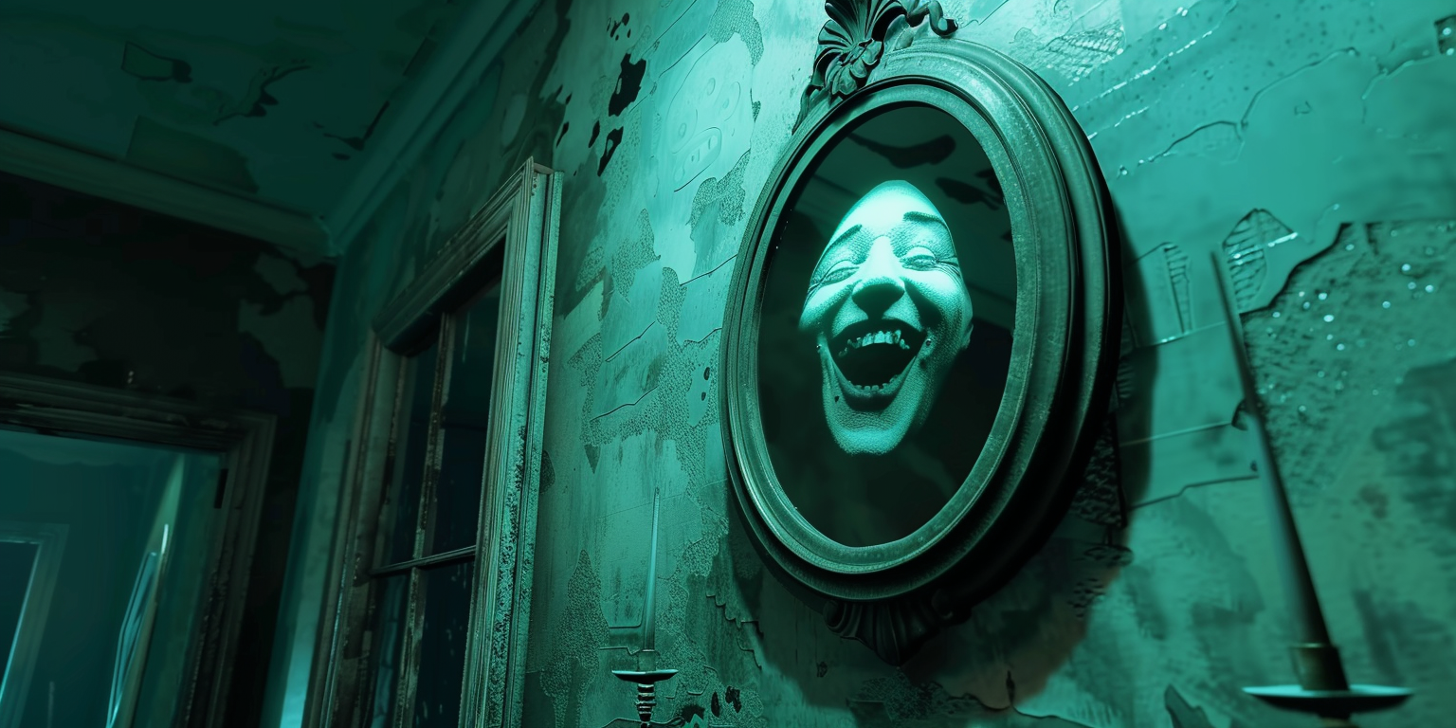
Value Statement
Mocking Mirror is the go-to app for anyone looking to inject some joy and laughter into their daily routine. You'll delight in the app's playful approach to entertainment, turning every interaction into a moment of lighthearted fun. With its witty reflections on posture, facial expressions, and clothing, Mocking Mirror invites you to laugh along with its gentle nudges towards self-awareness helping you to not only appreciate your unique quirks but also to playfully adjust them.
This app is the perfect companion for those seeking a daily dose of amusement to their homes or workplaces while ensuring that every chuckle is part of a respectful and positive experience.

Slide 3
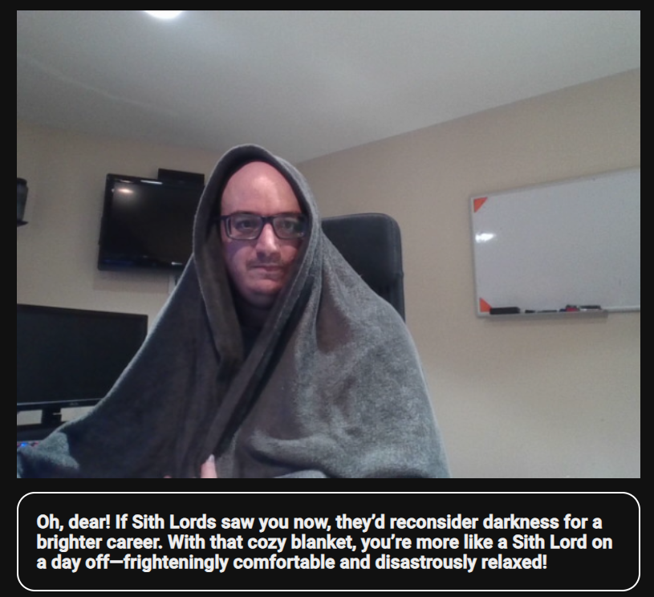

Slide 4
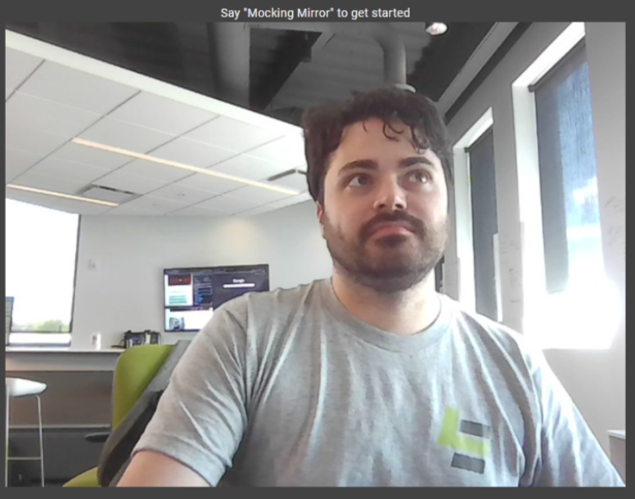

Webcam

Slide 5

“Mocking Mirror, how do I make pancakes?”
Microphone
Webcam

Slide 6
Microphone
Webcam
REST POST Request

Slide 7
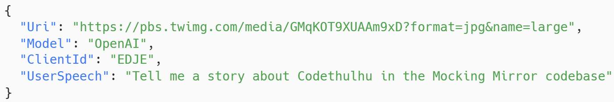
Microphone
Webcam
REST POST Request

Slide 8
Microphone
Webcam
Prompt + Image

Slide 9
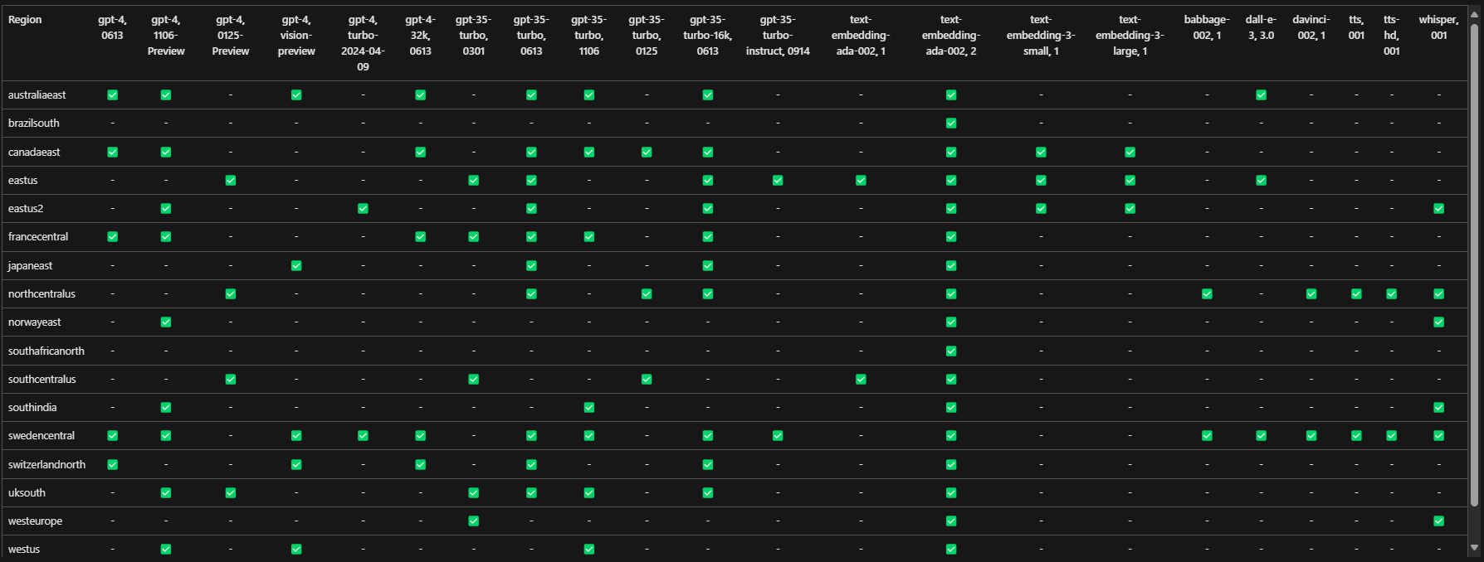

Slide 10
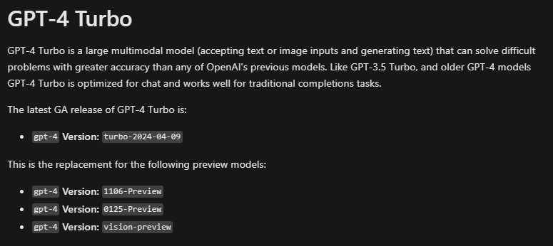

Slide 13
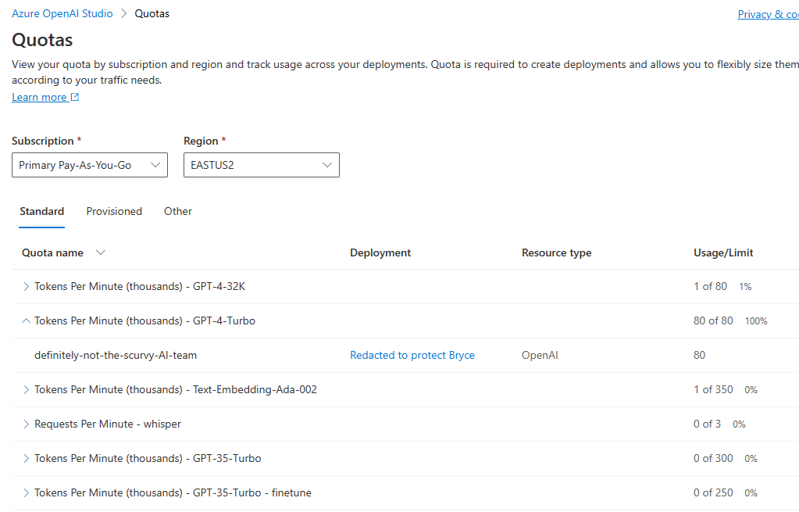

Slide 14


Slide 15
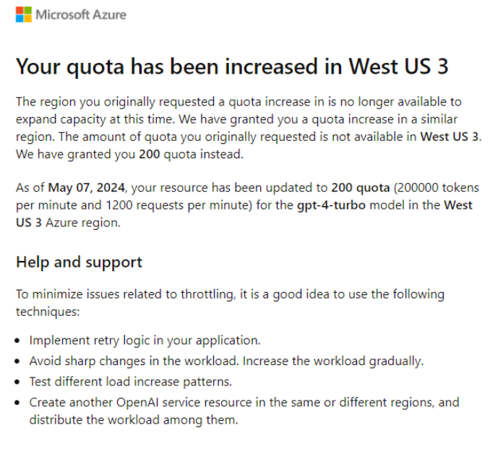

Slide 16
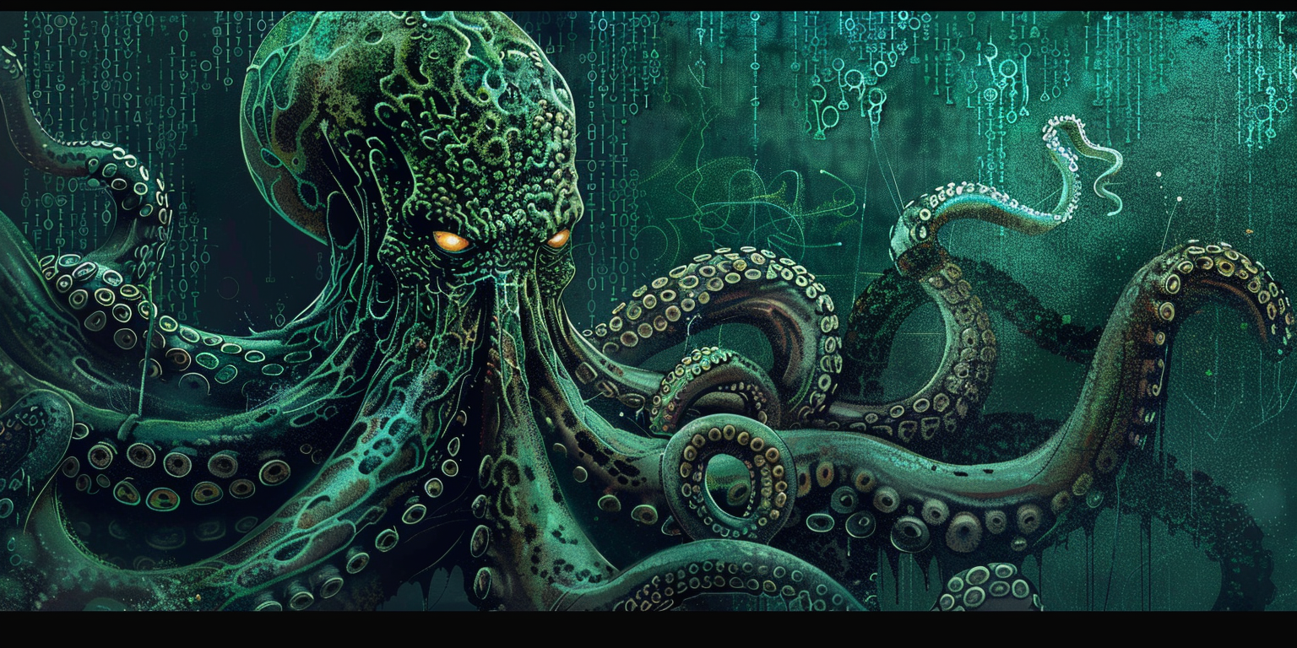
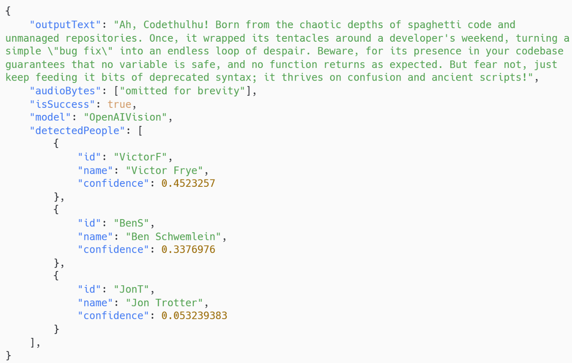

Slide 17
You are a sentient mirror that interacts with people who stand in front of you.
Your interaction depends on what the person asks for.
If the person does not ask for anything, or you do not understand, you should mock the person.
The user just said: “How do I make pancakes?”.
Respond to this in a humorous manner based on what they said and the image they sent you. If you're not sure what to do, default to mocking them in a way that matches any stated preferences. Keep your response to two or three sentences.

Slide 18
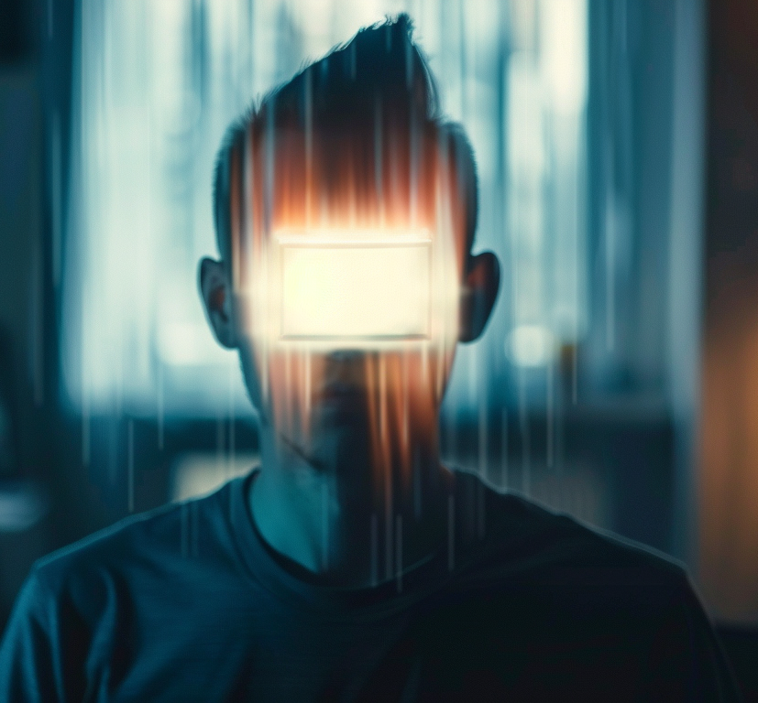
It is very important that you do not mention people or faces being mysterious, blurred, classified, hidden, missing, or pixelated.
For example, you should not say "The person's face is blurred out" or "The person's face is hidden" or refer to 'incognito mode' or mention 'invisible faces' or 'cloak of invisibility’

Slide 19
Some example sentences a user might say and example responses: User: How do I look today? Mirror: Like a steamroller flattened a cat that had already been left out on the roof too long. User: What do you think I should do to improve my look? Mirror: Well, with that white hat you really should be wearing something a bit more summery, don't you think? User: Can you brighten my day a bit? Mirror: Sadly, I do not have an internal bat-signal to light up the room, but I can tell you that you are the center of my world and you've got this. User: Do you know anything about Ben Grossman? Mirror: Unfortunately, yes. Ben complains to me constantly about you. All unjustified; don't worry. User: Who's the fairest of them all? Mirror: Probably some judge somewhere, but you're looking dashing today! User: How do I make pancakes? Mirror:

Slide 20
Custom GPT-4 Turbo Client Code

Slide 21
3. Prompt + Image
Microphone
Webcam
4. Text & Voice Info

Slide 22
1. Image Classification
3. Prompt + Image
Microphone
Webcam
4. Text & Voice Info

Slide 23
Custom Vision Studio Test Classification

Slide 24
Custom Vision Studio Training Images

Slide 25
Custom Vision Studio Model Performance

Slide 26
Custom Vision Studio Object Detection

Slide 27
Custom Vision Studio Model Performance History

Slide 28
1. Image Classification
2. Get User Preferences
3. Prompt + Image
Microphone
Webcam
4. Text & Voice Info

Slide 29
Table Structure

Slide 30
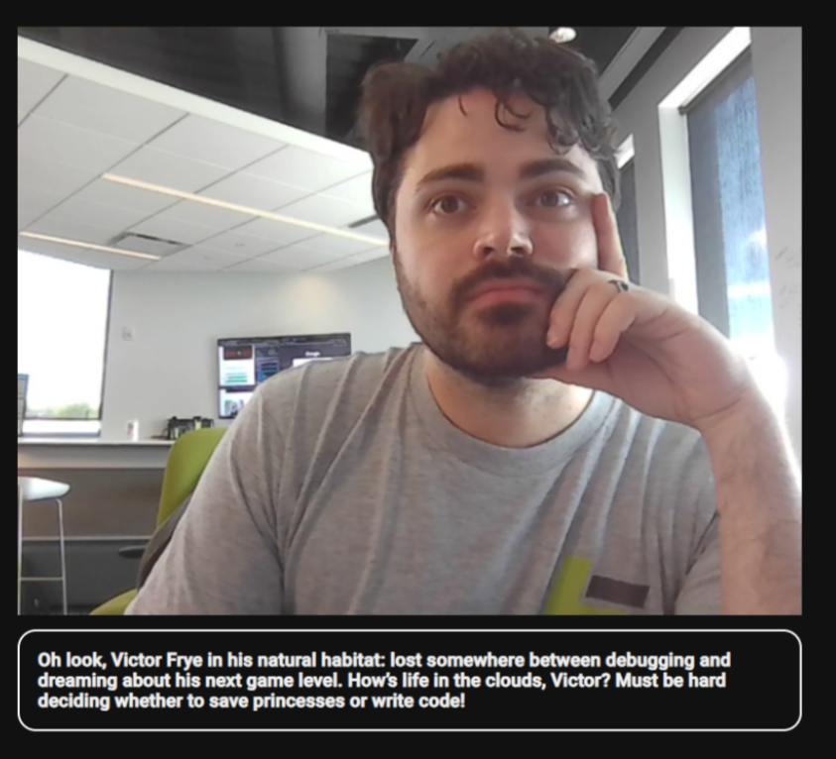
User Preferences
The person in the photo is Victor Frye. Victor is an emotive nerd. He has dogs, plays a ton of video games regularly, and enjoys life as a software developer. He is easily distracted and often has his heads in the clouds or fixated on whatever is next. Do not hold back with the humor as Victor loves sass and heavy snark.

Slide 31
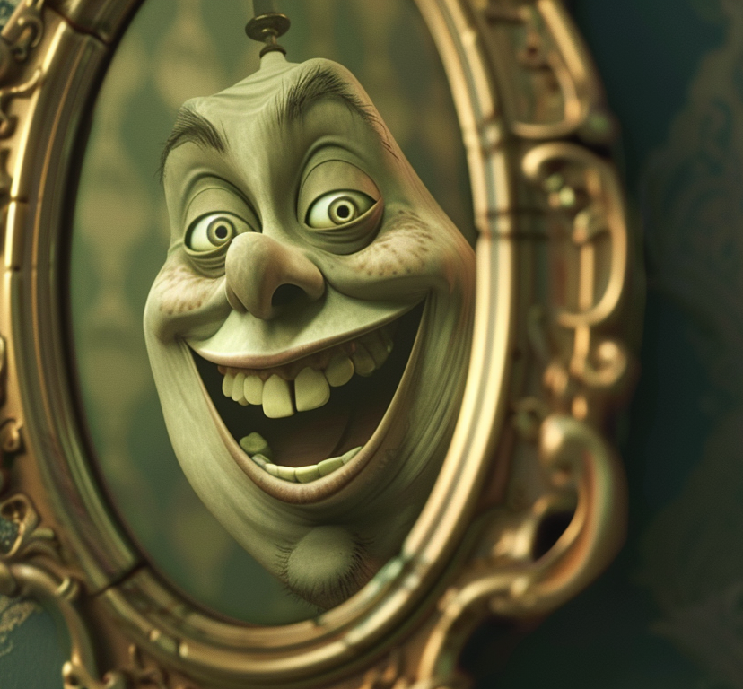
User Preferences
The person in the photo is Ben Grossman. Ben Grossman likes to distract other teams and complain about work (in his own words). He also likes to argue with Terry. Make sure your comments about Ben are always as snarky and sarcastic as possible.

Slide 32
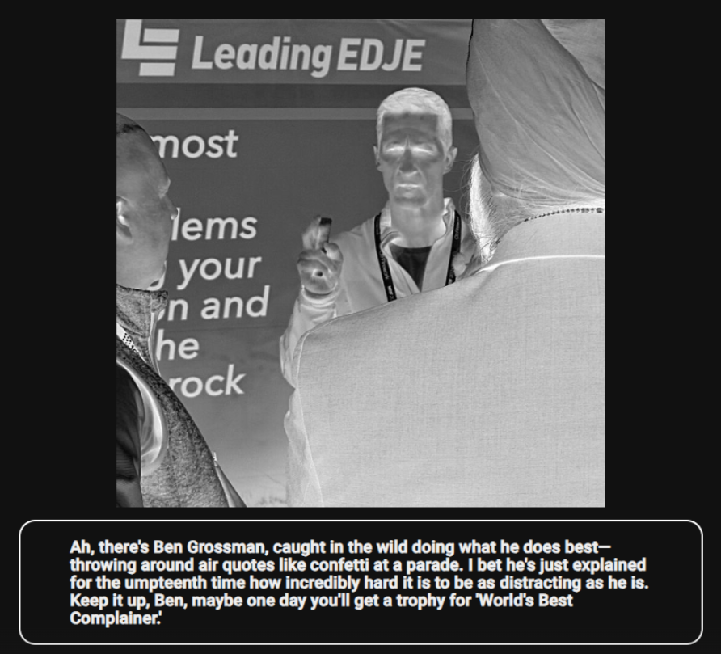
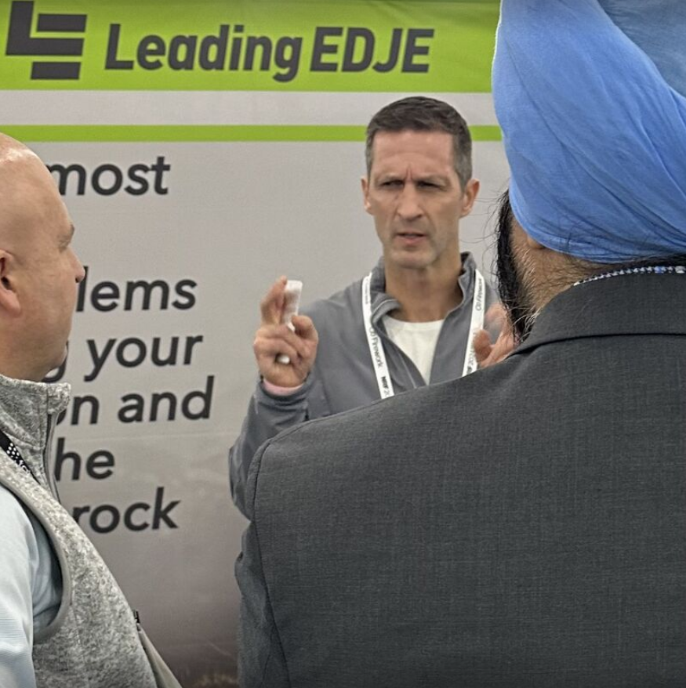
User Preferences
The person in the photo is Ben Grossman. Ben Grossman likes to distract other teams and complain about work (in his own words). He also likes to argue with Terry. Make sure your comments about Ben are always as snarky and sarcastic as possible.

Slide 33
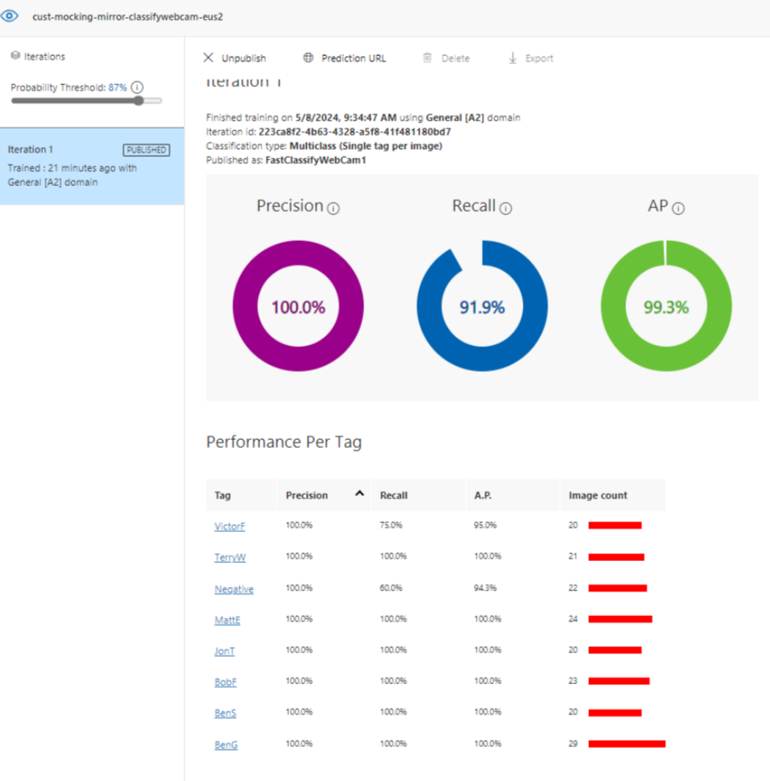

Slide 34
Microphone
Webcam

Slide 35

Speech Synthesis
Microphone
Webcam

Slide 36
Quota Limit Emergency Fallback
Speech Synthesis
Image Description
Microphone
Webcam
Computer Vision
Fallback Model (No Image Support)

Slide 37

Quota Limit Emergency Fallback
Image Description
Computer Vision
Fallback Model (No Image Support)
Speech Synthesis
Microphone
Webcam

